Slide 1
Software Architecture
An Introduction
SWE 3633-Software Design & Architecture

Slide 2
SOFTWARE ARCHITECTURE
Software architects use various design strategies in software construction to divide and conquer the complexities of a problem domain and solve the problem.

Slide 3
Software Engineering Design
Step-1: Architectural Design
Step-2: Detailed Design

Slide 4
Architectural Design
During the architectural design step we describe user accessible components and the interconnections among them that are visible to stakeholders.

Slide 5
Detailed Design
During the detailed design step we specify the internal details of each component and we might introduce new invisible components – to the stakeholder, into the design.

Slide 6
Detailed Design (cont.)
In practice, designers abstract common features such as similar choices on element types and connections into “families of architectures” using the notion of “architectural style.”

Slide 7
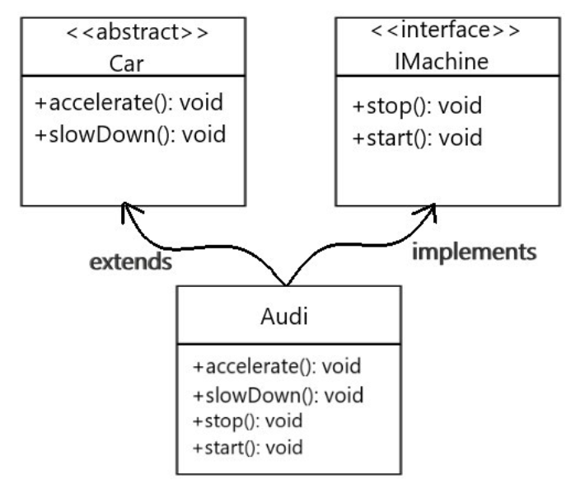
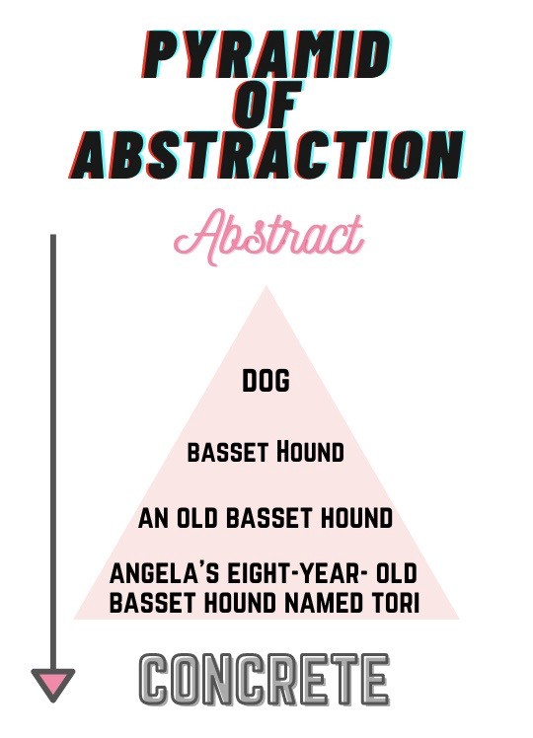
What is Abstraction?
From the textbook:
Abstraction is suppressing or ignoring some properties of objects, events, or situations in favor of others. Abstraction is an important problem-solving technique for two reasons:
Problem Simplification—Real problems always have many details irrelevant to their solution. For example, suppose you need to pack your belongings into a moving van. You need not consider the colors, patterns, or styles of your boxes and suitcases, nor the colors, patterns, fabrics, light, or sound in the back of the van. The only information you need to solve this problem is the shape and size of the van’s interior, and the shapes, sizes, weights, and load-bearing capacities of your parcels. You can concentrate on the pertinent features of the problem without having to keep other details in mind.

Slide 8
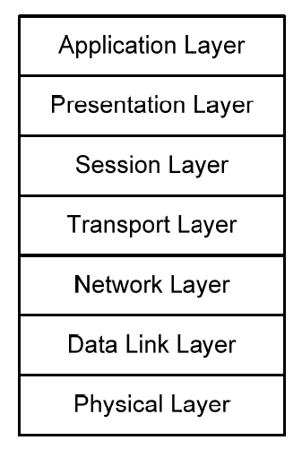
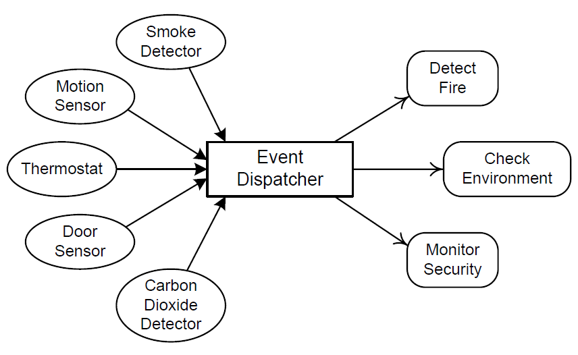
What is an Architectural Style?
From the textbook:
An architectural style is a paradigm of program or system constituent types and their interactions. There are about six standard styles suitable for a wide variety of programs. An architect can begin with an architectural style and elaborate it to produce candidate architectures. Two examples from chapter 15… layered and event driven:

Slide 9
Architectural Style (cont. 1)
Each style represents a layout topology of elements, and connections and interactions among these.

Slide 10
Architectural Style (cont. 2)
Quality attributes are closely related to architectural styles.

Slide 11
Quality Attributes
Performance
Reliability
Portability
Usability
Security
Testability
Modifiability
Etc.

Slide 12
Quality Features
Each architectural style supports some quality features.

Slide 13
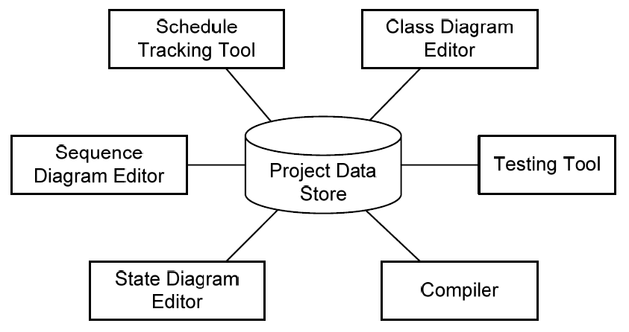
For example, there is always a tradeoff between system performance in terms of :
Time
Resource
System Reliability
Availability.

Slide 14
Software Architecture: Bridging Requirements and Implementation
The actual design is a blueprint and a guideline for developing a software system based on the software requirement analysis specification.

Slide 15
Architectural design
The architectural design embodies earliest decisions that have a decisive impact on the ultimate success of the software product.
Choose carefully!

Slide 16
Architectural Design (cont. 1)
As the description of software construction structure, an architectural design must cover the software functional requirements and non-functional requirements as well.

Slide 17
Architectural Design (cont. 2)
It shows how the system is structured in terms of components, and how its components work together.

Slide 18
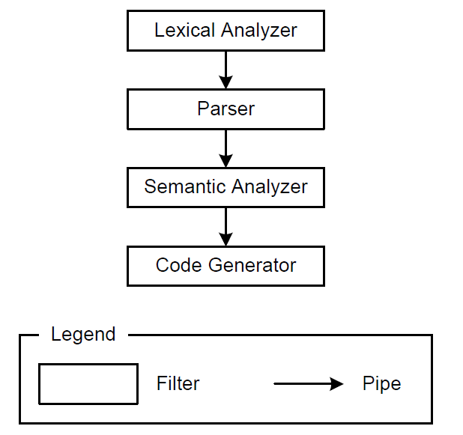
SUB-SYSTEMS
A system in its own right whose operation does not depend on the services provided by other sub-systems.

Slide 19
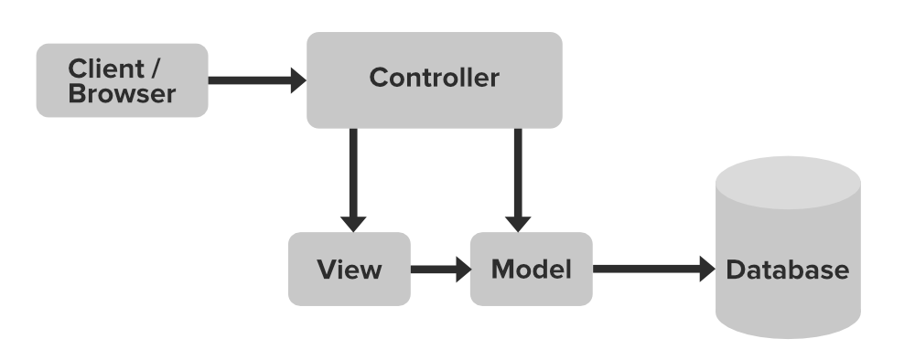
SUB-SYSTEMS
Are composed of modules and have defined interfaces which are used for communication with other sub-systems.
Web App

Slide 20
MODULES
A module is a system component that provides one or more services to other modules.
Web App

Slide 21
MODULES – cont.
It makes use of services provided by other modules.
It is not normally considered to be an independent system.

Slide 22
Software Architecture Specification
Must describe not only the elements and connections between elements but also the constraints and runtime behaviors so that developers know what must be implemented and how it should be implemented.

Slide 23
Software Architect’s Tasks
1. Perform system static partitioning and decomposition into sub-systems and communications between sub-systems.

Slide 24
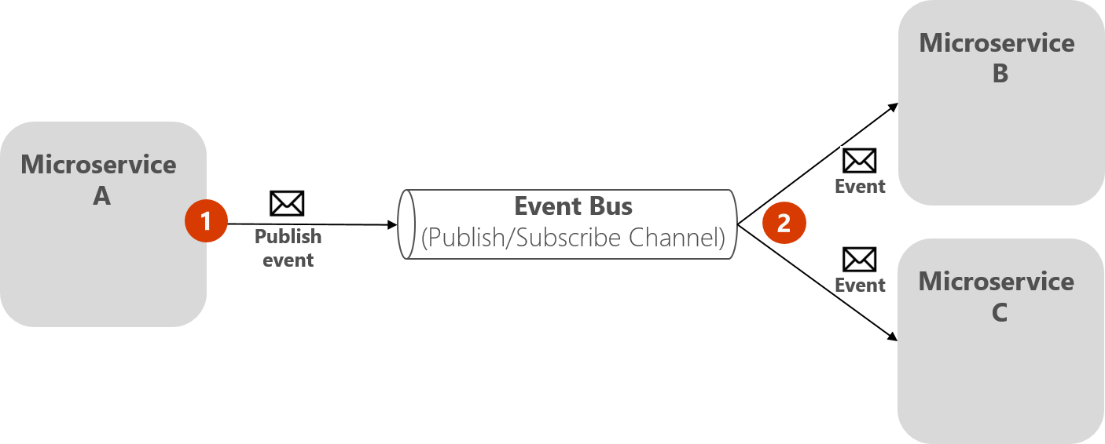
Software architect’s tasks –cont.
2. Establish dynamic control relationships between different sub-systems in terms of data flow, or control flow orchestration, or message dispatching.

Slide 25
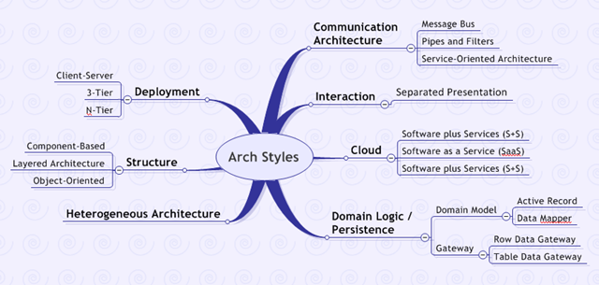
Software architect’s tasks – cont.
3. Consider and evaluate alternative architecture styles for the problem at hand.

Slide 26
Software architect’s tasks –cont.
4. Perform trade-off analysis on quality attributes and other non-functional requirements during the selection of architecture styles.

Slide 27
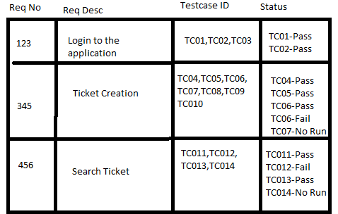
Software architect’s tasks – cont.
5. Map the software requirements specification to the software architecture and guarantee that the software architecture satisfies functional and non-functional requirements (very important task).

Slide 28
Architectural Styles
An architectural style (also known as “architecture pattern”) abstracts the common properties of a family of similar designs.

Slide 29
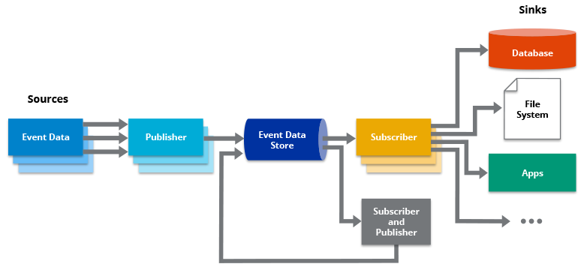
Architectural Styles – cont.
An architectural style contains a set of rules, constraints, and patterns of how to structure a system into a set of elements and connectors.

Slide 30
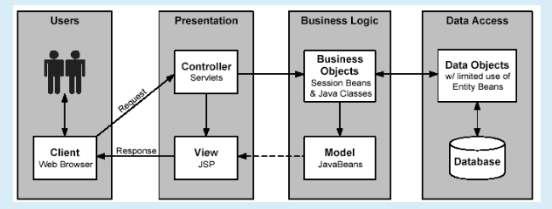
Architectural Styles – cont.
It governs the overall structure design pattern of constituent element types and their runtime interaction of flow control and data transfer.

Slide 31
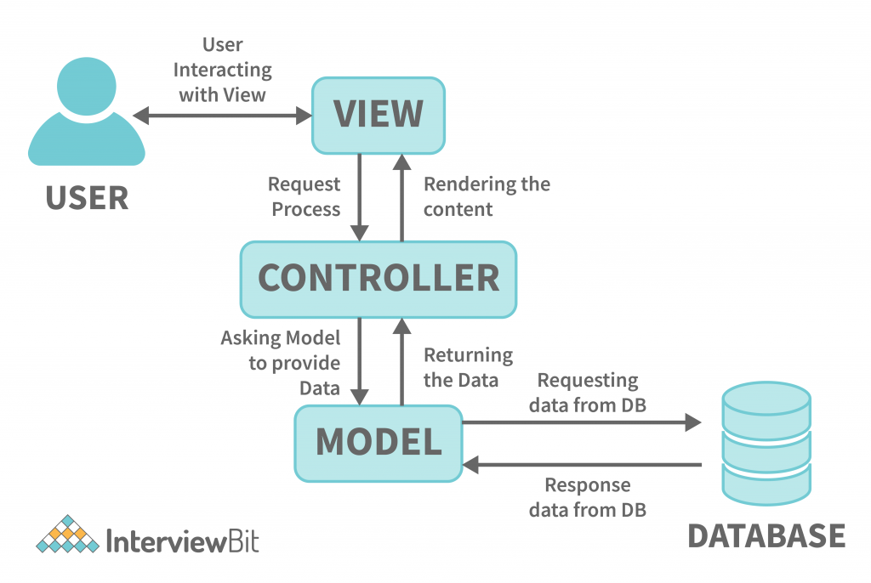
key components of an architectural style
Elements
Connectors
Constraints
Attributes

Slide 32
Elements
Elements that perform functions required by a system

Slide 33
Connectors
Connectors that enable communication, coordination, and cooperation among elements

Slide 34
Constraints
Constraints that define how elements can be integrated to form the system

Slide 35
Attributes
Attributes that describe the advantages and disadvantages of the chosen structure

Slide 36

Software Architecture Design Guidelines
Think of what to do before thinking of how to do it.

Slide 37
Software Architecture Design Guidelines – cont.
Functional and non-functional requirements should be identified, verified, and validated (i.e, product design) before architectural and detailed design (i.e, software engineering design)

Slide 38
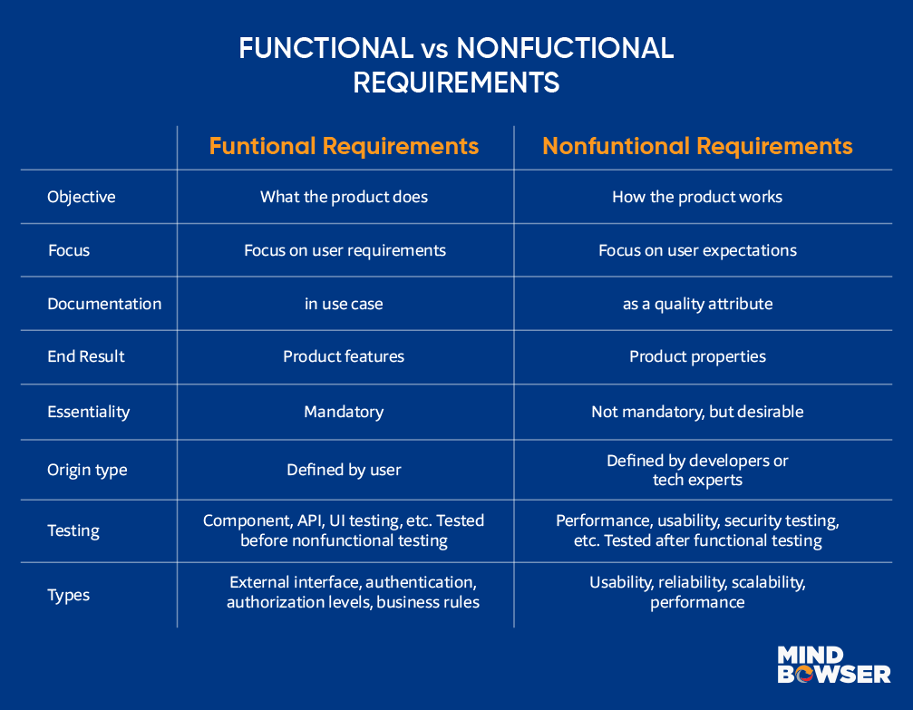
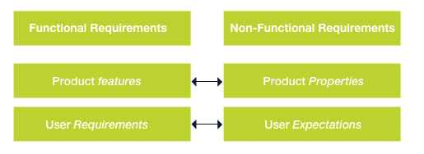
Software Architecture Design Guidelines –cont.
Difference between functional and nonfunctional requirements.

Slide 39
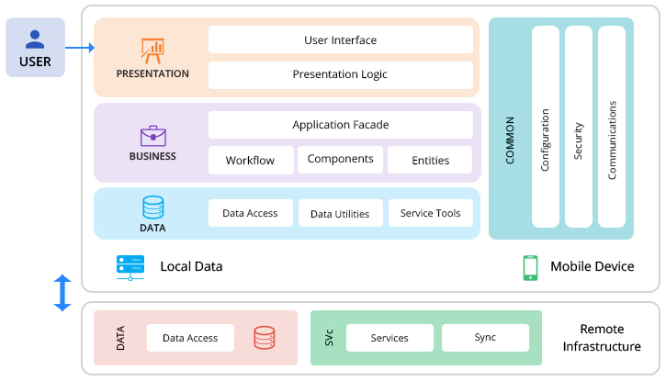
Software Architecture Design Guidelines –cont.
Using an abstract architectural design of a system to communicate with stakeholders helps avoid overhauling the system design in later stages of the software development cycle.

Slide 40
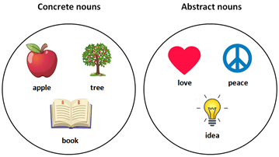
Software Architecture Design Guidelines – cont.
Think of abstract design before thinking of concrete design.

Slide 41
Software Architecture Design Guidelines – cont.
Always start with an abstract design that specifies interfaces of components and abstract data types.

Slide 42
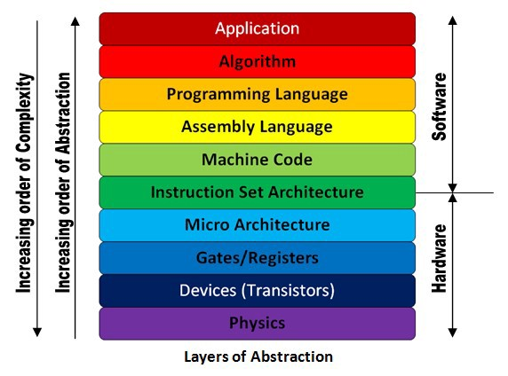
Software Architecture Design Guidelines – cont.
Use multiple levels of abstraction if necessary.

Slide 43
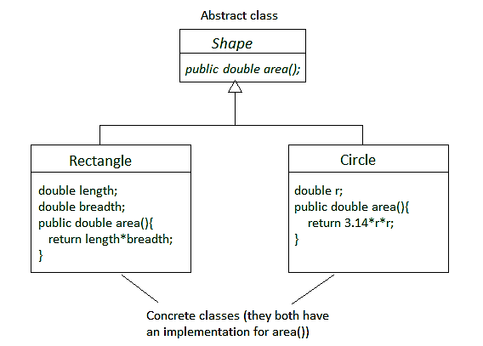
Software Architecture Design Guidelines – cont.
Make all implementation decisions depend on the abstract interfaces instead of concrete ones because those are more stable – they are the contracts between service providers and services requesters so they are defined at the early stages of software development cycle.

Slide 44
Software Architecture Design Guidelines – cont.
Think of non-functional requirements earlier.
When we map functional requirements to an architectural design, we should consider non-functional requirements as well.

Slide 45
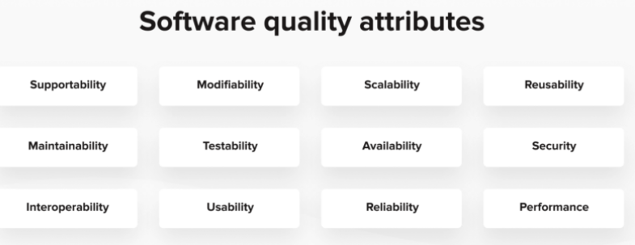
Software Architecture Design Guidelines – cont.
Communicate with stakeholders and document their preferences of quality attributes.

Slide 46
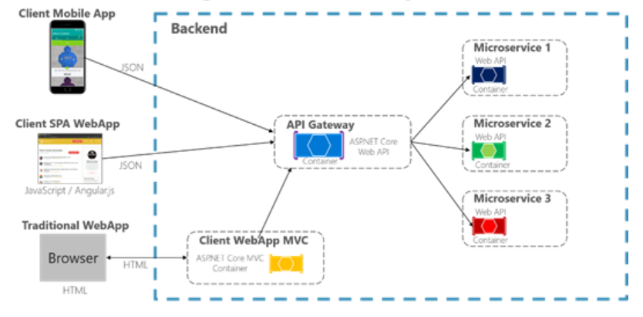
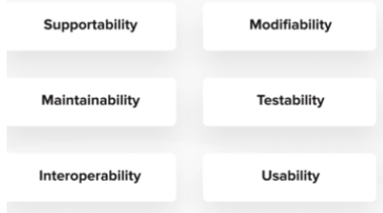
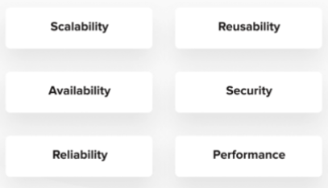
Software Architecture Design Guidelines – cont.
Balance the quality attributes, and consider heterogeneous architecture styles when necessary.
(It is not possible to find a design that meets all quality attributes)

Slide 47
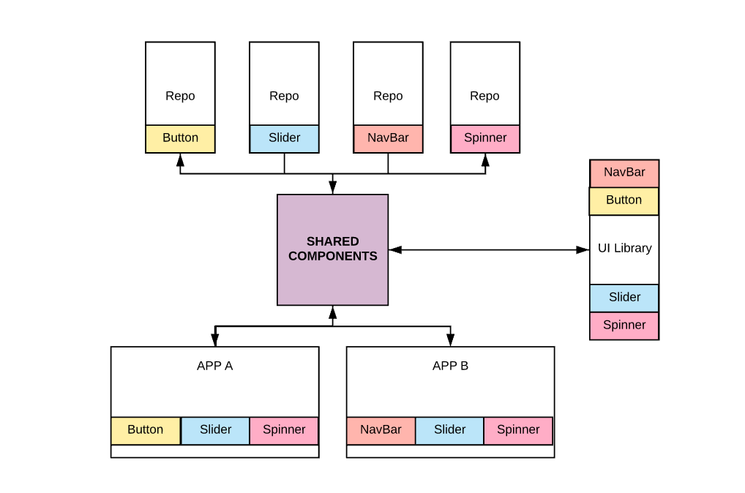
Software Architecture Design Guidelines – cont.
Think of software reusability and extensibility as much as possible.

Slide 48
Software Architecture Design Guidelines – cont.
For most software systems, it is very likely that new functionalities will be added after they are deployed.

Slide 49
Software Architecture Design Guidelines – cont.
In addition, we need to consider how to reuse existing software components to increase the reliability and cost-effectiveness of new systems.

Slide 50
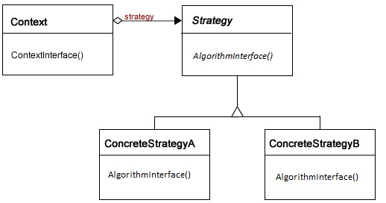
Software Architecture Design Guidelines – cont.
Always try hard to make software extensible in the future.

Slide 51
Software Architecture Design Guidelines – cont.
Tolerate refinement of design.
From the textbook…
We call this process refinement. This
top-down strategy is very common in design. Consider, for example,
the design of a large building complex, such as a university campus or an
office park. Designers begin by abstracting all features of the buildings
except their locations, masses, and functions. At this level of abstraction,
the focus is on satisfying goals and constraints concerning traffic,
parking, sight lines, building access, topography, and the relationships
between the development and adjoining land and structures. Once this
part of the problem is solved, details are added as the buildings’
footprints, facades, and connections are developed. Refinement
continues until the entire design problem is solved.

Slide 52
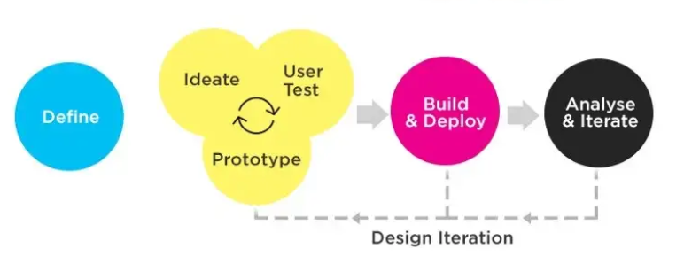
Software Architecture Design Guidelines – cont.
Never expect to have software design completely perfect within one step.

Slide 53
Software Architecture Design Guidelines – cont.
We may need to use prototyping and iteration to refine the software design.

Slide 54
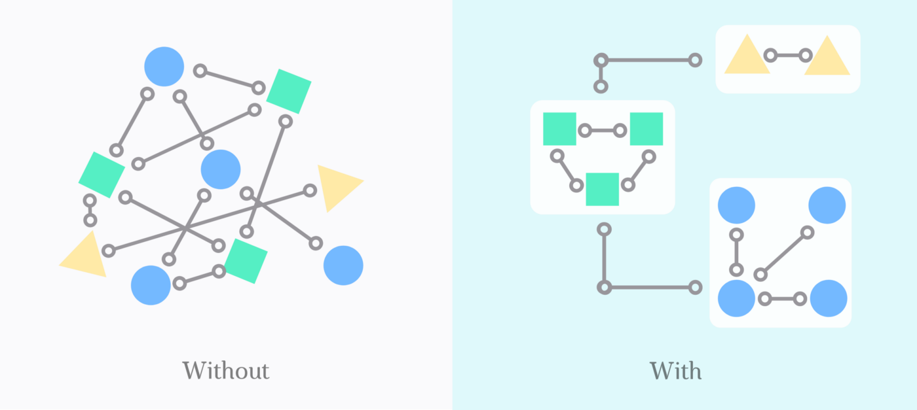
Software Architecture Design Guidelines – cont.
Try to promote high cohesion within each element and loose-coupling between elements.

Slide 55
Summary
Software architectural design has emerged as an important part of software development.

Slide 56
Summary
A software architecture specification consists of software elements, connections and collaborations among the elements, and desired software quality attributes.

Slide 57
Summary
An architectural style is a set of rules, constraints, or patterns that guide how to structure a system into a set of elements and connectors, and how to govern overall structure design patterns of constituent element types and their runtime interaction.

Slide 58
Summary
One specific architectural style may not be able to honor all quality attributes of the system.

Slide 59
Summary
There are always quality attribute tradeoffs between different styles.
Hence how to keep a balance on quality attributes is an important design issue.

